Slide 1

EDA analysis
Tangbufan Wei(victor)

Slide 2
contents
1.Introduction
2.Problem statement
4.Clean the data
6..Conclusion
5.Data analysis
3.Understand the data

Slide 3

1. INTRODUCTION

Slide 4

WHAT IS EDA?
Exploratory Data Analysis (EDA) is a crucial phase in the data analysis process, serving as the compass that guides us through the vast landscape of data. In real-world applications, EDA is the compass that helps us navigate complex datasets, revealing valuable insights, patterns, and outliers hidden within the numbers. Whether it's uncovering market trends from sales data, optimizing manufacturing processes, or understanding customer behavior through transaction records, EDA empowers us to make informed decisions and extract actionable knowledge from the data at hand. This essential step transforms raw data into a treasure trove of information, unlocking opportunities for improved decision-making and innovation in various industries and domains.

Slide 5

2.Problem statement

Slide 6

What are we facing?
The objective of this case study is to unearth significant patterns that can act as early signals indicating clients who might encounter challenges in repaying their loan installments. These identified patterns will enable the company to take appropriate measures, including loan denial, reducing loan amounts, or offering loans to higher-risk applicants at elevated interest rates. This strategic approach seeks to strike a balance between approving deserving loan applicants while mitigating the risk of loan defaults. Our primary emphasis revolves around pinpointing the key variables that strongly correlate with loan defaults, providing invaluable insights for effective portfolio management and risk assessment within the company's operations. Through the utilization of Exploratory Data Analysis (EDA), this case study endeavors to shed light on these influential factors, empowering the company with the knowledge needed for sound loan decision-making and risk mitigation

Slide 7

3. Understand the data and approaches

Slide 8

Understand the data
Loan providers often face challenges when dealing with insufficient credit history, which can lead to certain consumers exploiting the system through loan defaults. In your role as an employee of a consumer finance company with expertise in urban lending, your responsibility is to conduct a thorough analysis of data patterns using Exploratory Data Analysis (EDA). The ultimate objective is to prevent the unnecessary rejection of qualified loan applicants by accurately identifying their repayment potential.

Slide 9
Approaches
1.Import the data.
2. Impute the data.
3.Data analysis.
4. Conclude what we got.

Slide 10

4. Clean the data

Slide 11
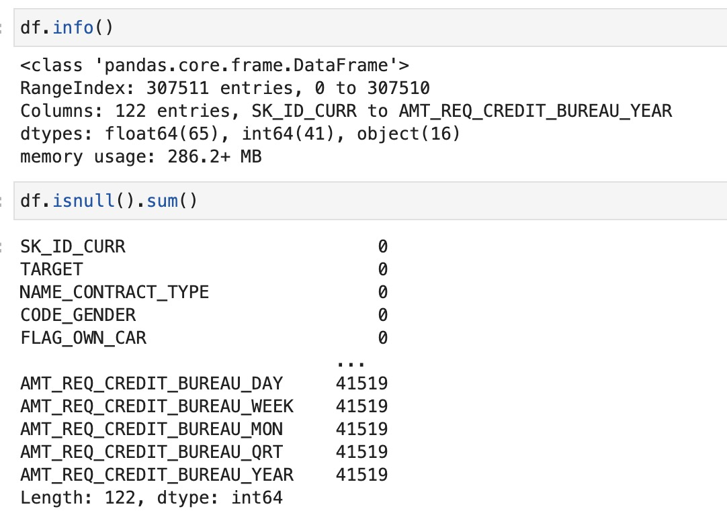
Begin with dataset Application
1.We first load the datasets and some libraries needed.
2.Then use python commands to explore the data.
3.Removing columns with more than 50% missing values.
4.Getting rid of those unrelated columns as well.

Slide 12

5. Data analysis

Slide 13
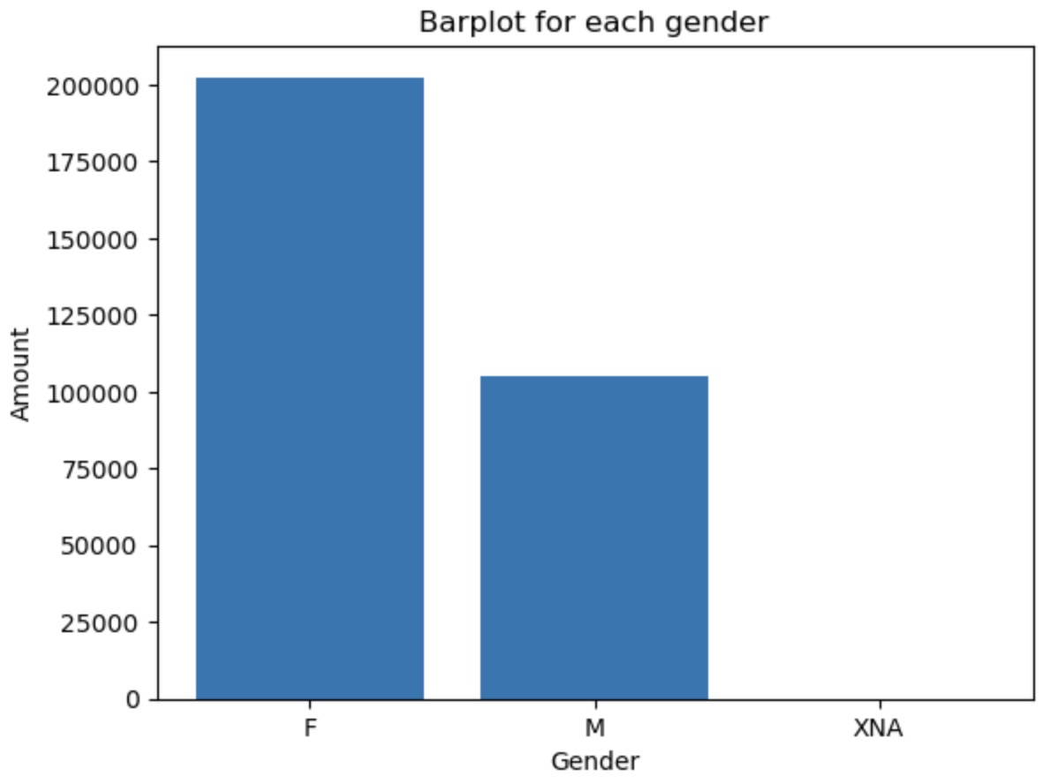
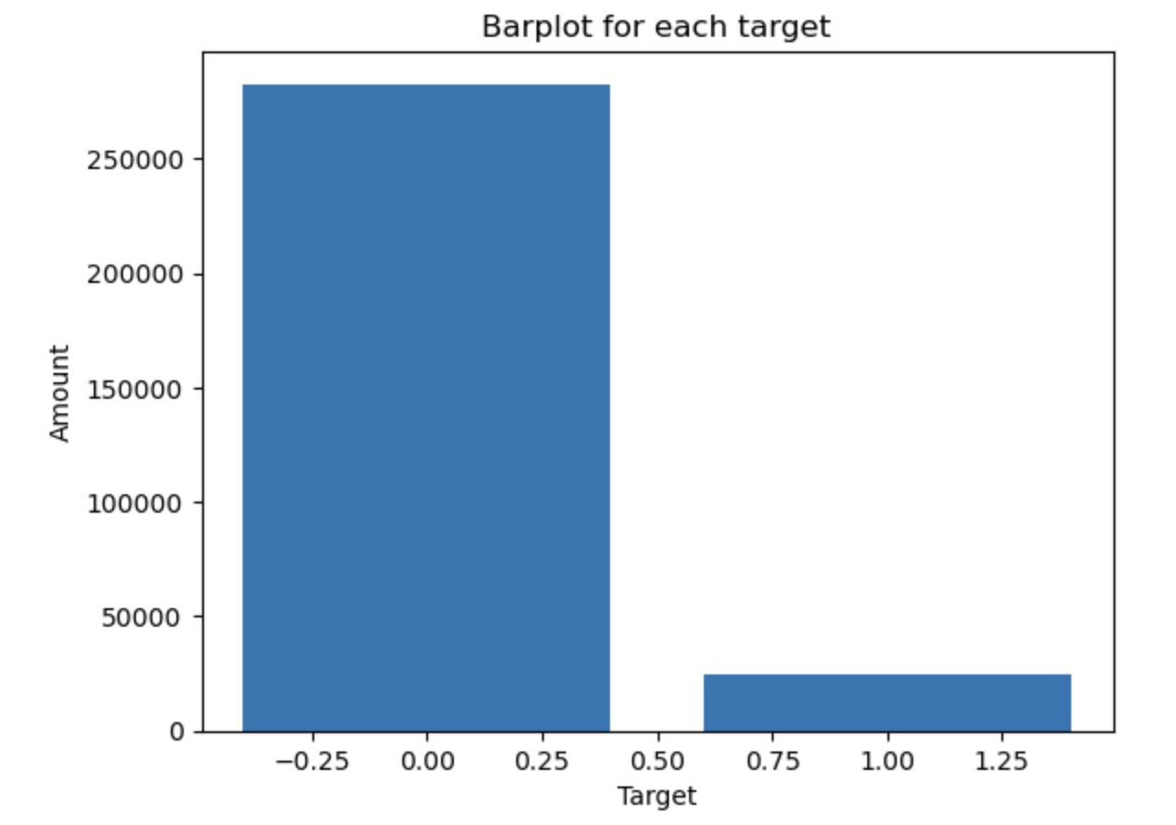
Imbalance analysis
Regarding the gender breakdown, there is an imbalance of 65.84% in favor of females and 34.16% for males.
The imbalance percentages between Non-Defaulter (Repayer) and Defaulter data stand at 91.93% and 8.07%, respectively. This results in a relative imbalance ratio of approximately 11.39:1.

Slide 14
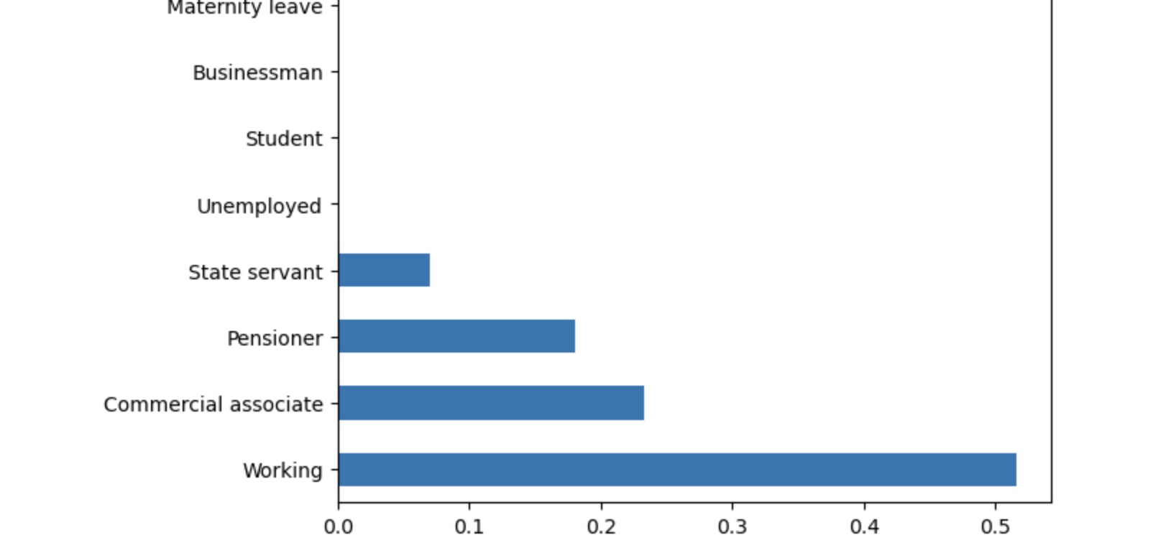
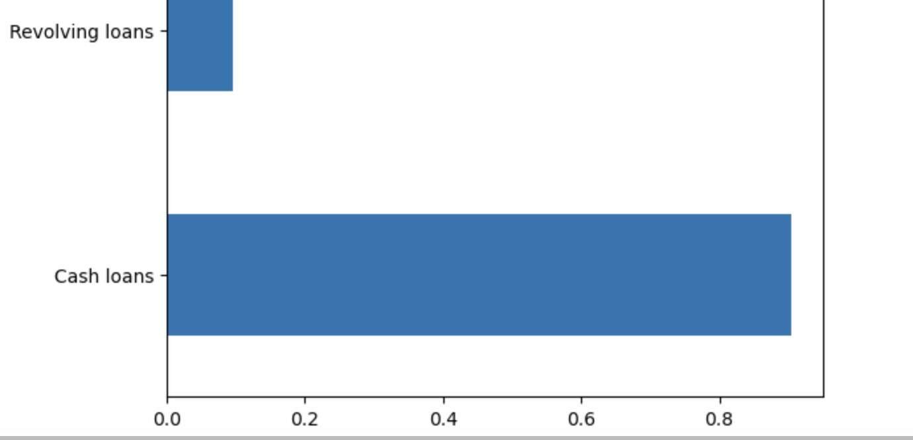
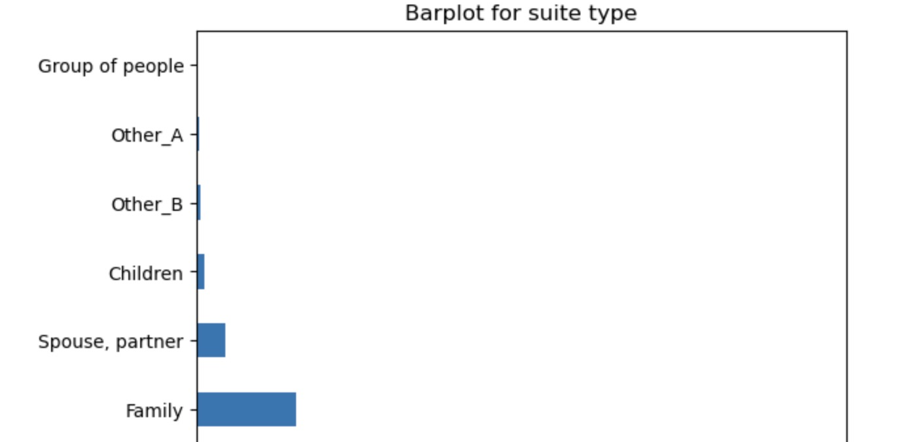
Analysis for categorical variables
In the bar plot for income type, we observe that the majority of applicants fall under the "Working" category, indicating that a significant portion of loan applicants are employed. This is followed by "Commercial Associate" and "Pensioner" categories. "Working" stands out as the most common income source among loan applicants.
When examining the contract type, we find that "Cash Loans" dominate the distribution, implying that a substantial portion of applicants opt for this type of contract. "Consumer Loans" and "Revolving Loans" follow but are less frequent. "Cash Loans" appear to be the preferred contract choice among applicants.
Looking at suite type, "Unaccompanied" individuals occupy the largest portion, suggesting that many loan applicants are applying as individuals without co-applicants or family members. "Family" and "Spouse, Partner" categories are less common. "Unaccompanied" individuals seem to represent a significant segment of the applicant pool.

Slide 15
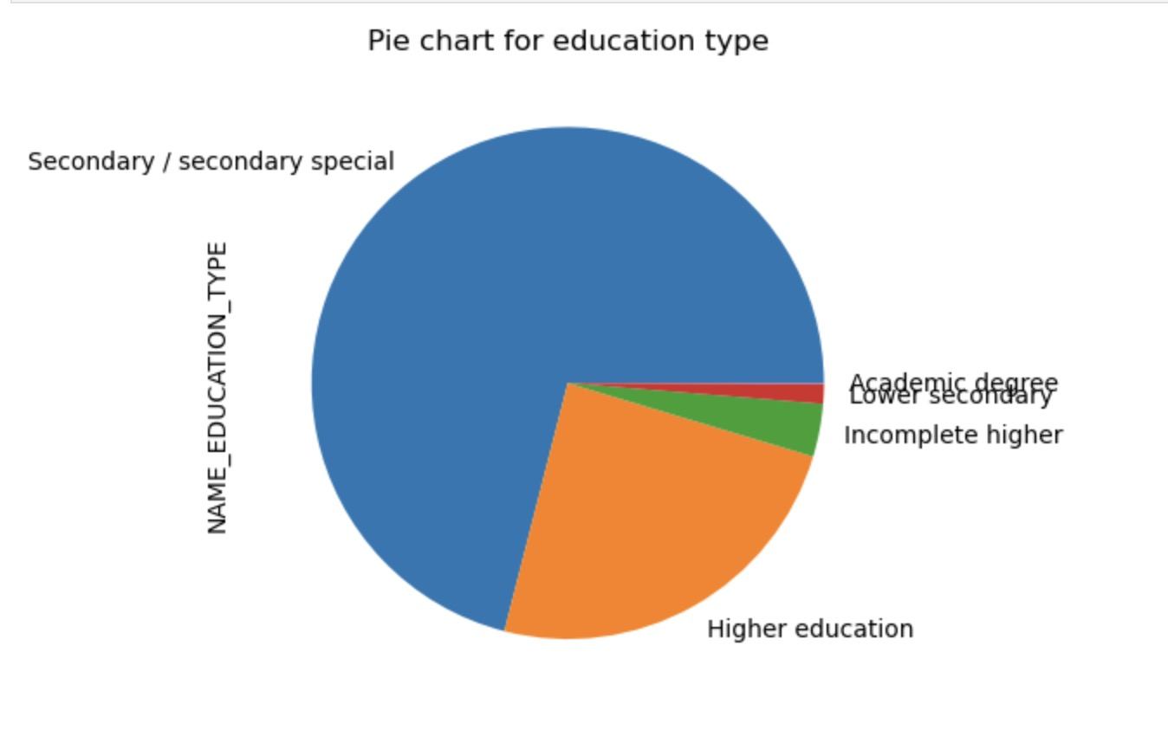
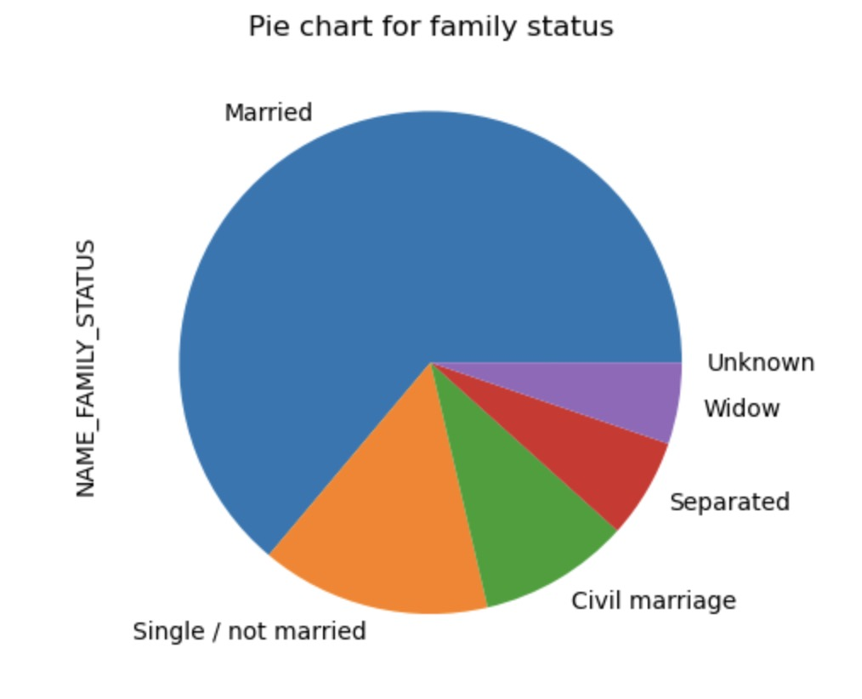
In the pie chart for family status, the largest segment is "Married," indicating that a significant proportion of loan applicants are married individuals. This category dominates the distribution, followed by "Single/Not Married," "Civil Marriage," "Separated," and "Widow." "Married" applicants constitute the most substantial portion of the family status categories.
When examining the pie chart for education type, "Academic Degree" stands out as a noteworthy category, implying that a notable proportion of applicants have achieved higher education levels. Other categories like "Secondary / secondary special," "Incomplete higher," "Lower secondary," and "Higher education" also contribute, but "Academic Degree" represents a distinct portion of the education background among loan applicants.
These pie charts offer a visual representation of the distribution of loan applicants across different family status and education type categories, highlighting the prominence of "Married" and "Academic Degree" categories within their respective variables.

Slide 16
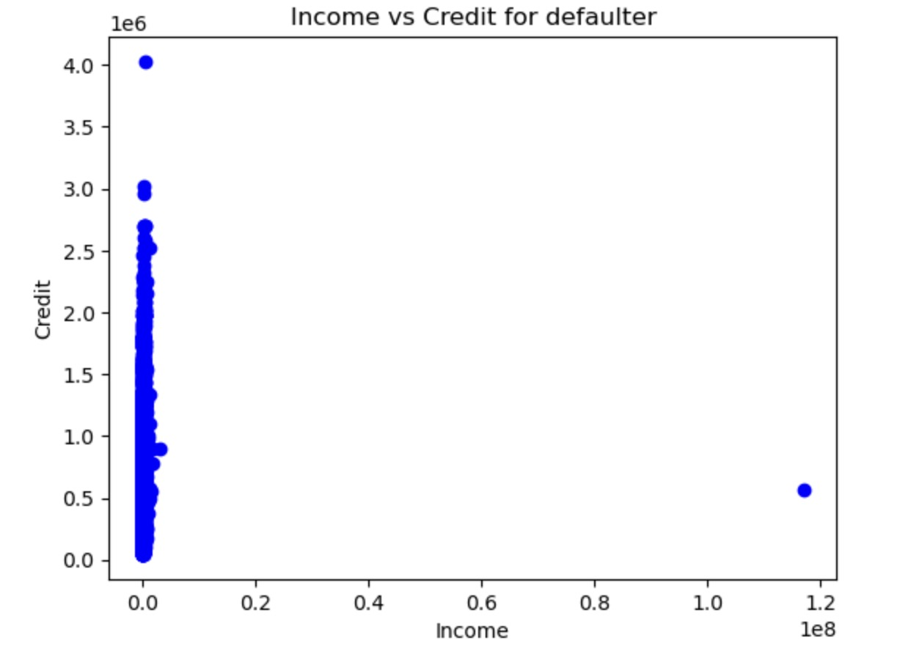
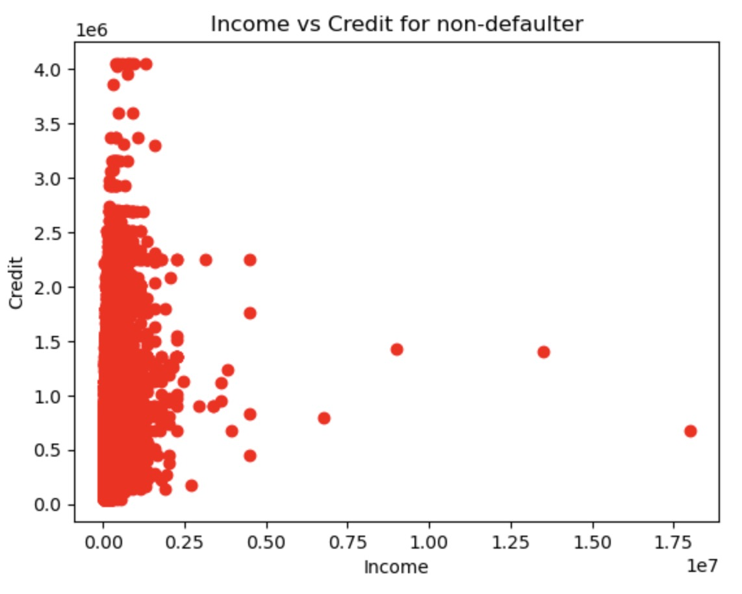
Bivariate analysis
In the scatter plot for defaulters, we observe that data points are more concentrated and tend to cluster around a vertical line. This concentration suggests that defaulters exhibit less variability in their income-to-credit ratios. It implies that a significant portion of defaulters falls within a specific range of income relative to their credit.
Conversely, in the scatter plot for non-defaulters, the data points appear more uniformly scattered across the graph. This distribution indicates that non-defaulters have a broader range of income-to-credit ratios, and their points are less concentrated around a specific vertical line. It suggests that non-defaulters exhibit greater income diversity in relation to their credit.
These scatter plots visually depict the relationship between income and credit for both defaulters and non-defaulters, with a noticeable contrast in the distribution patterns. Defaulters tend to have a more clustered pattern, while non-defaulters display a more even dispersion of data points along the graph.

Slide 17
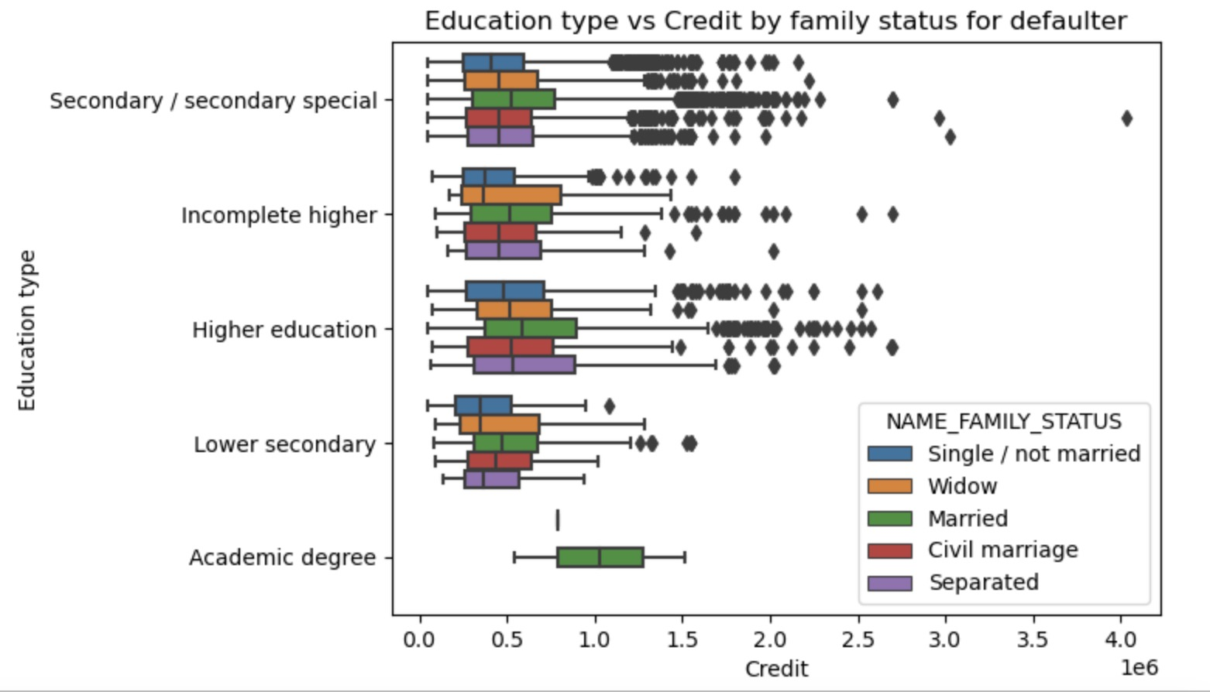
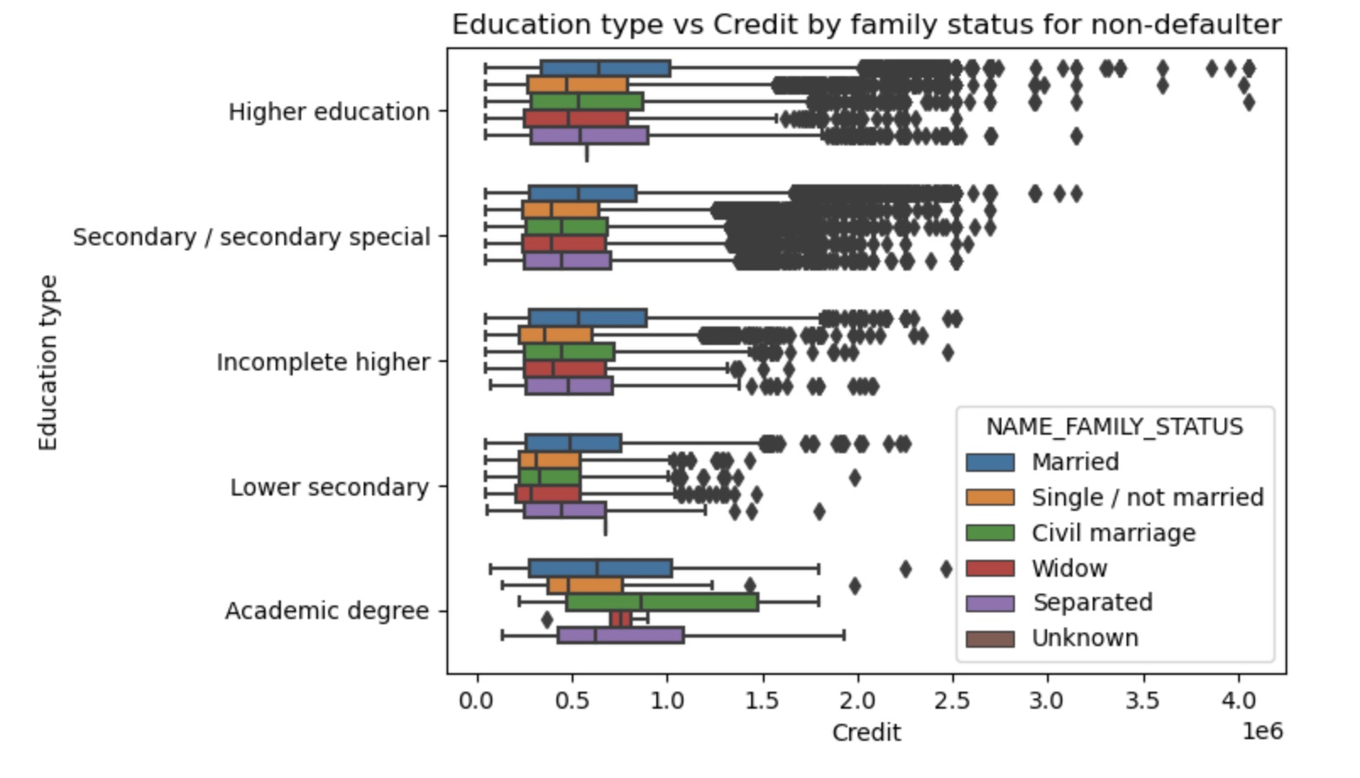
Married individuals with advanced educational backgrounds typically exhibit elevated credit scores in contrast to those with lower secondary education levels.
Individuals with higher educational attainment generally maintain superior credit scores and are more inclined to meet their payment deadlines.
A greater frequency of outliers is noticeable among individuals with advanced educational qualifications.
Individuals possessing secondary or secondary-special education qualifications are less likely to adhere to timely payment schedules.

Slide 18
PREVIOUS APPLICATION DATA
The "Previous Application" dataset holds details regarding clients' past loan applications, including their approval status (Approved, Cancelled, Refused, or Unused offer). By merging the "Previous Application" dataset with the "Application" dataset, we gain valuable insights into the factors that influence loan application decisions.

Slide 19
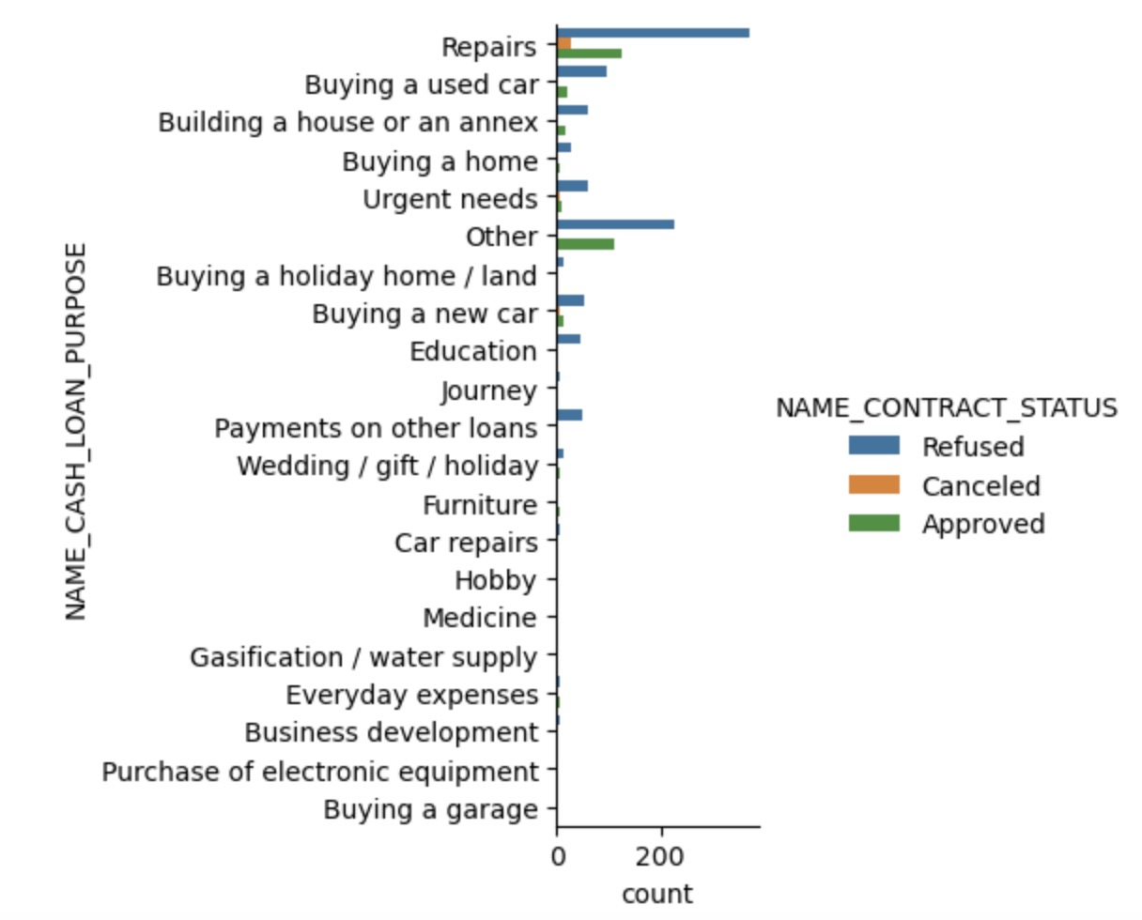
The most common reason for loan denials was 'Repairs.' In contrast, when it came to educational purposes, an equal number of approvals and rejections were noted. However, applications intended for debt consolidation and purchasing a new car exhibited a notably higher rate of rejections in comparison to approvals.

Slide 20
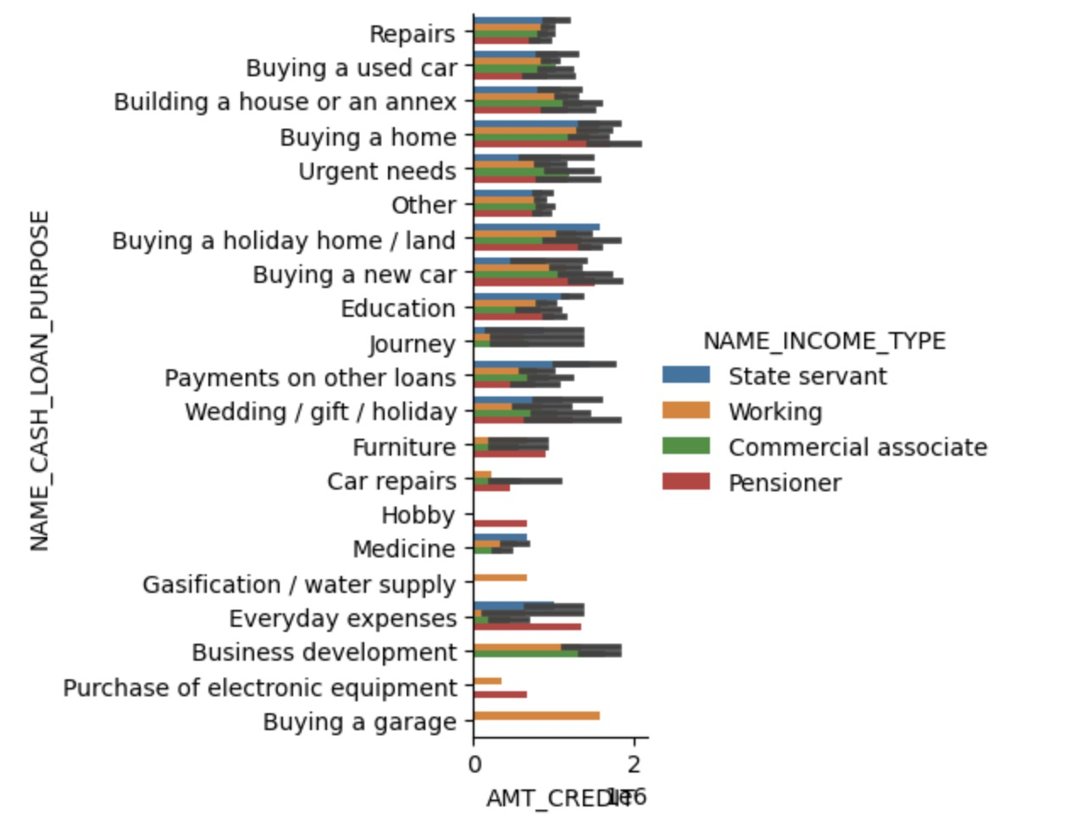
Loan purposes such as 'Home Purchase,' 'Land Purchase,' 'New Car Acquisition,' and 'House Construction' typically involve higher requested credit amounts.
State servants, identified by their income type, account for a substantial proportion of credit applicants.
In contrast, loans designated for assisting a third party or indulging in a hobby tend to be associated with lower requested credit amounts.

Slide 21
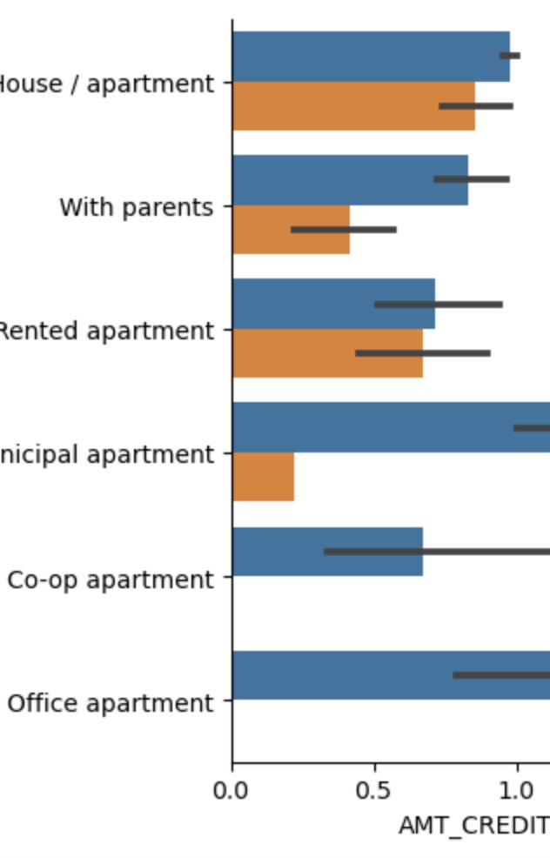
Among different housing types, it is noteworthy that office apartments tend to have higher credit amounts for clients with a 'target 0' status, indicating successful payments. Conversely, co-op apartments show higher credit amounts for clients with a 'target 1' status, suggesting payment difficulties.
Hence, it is prudent for the bank to exercise caution when considering loan approvals for co-op apartments, as clients in this category have demonstrated challenges in meeting their payment obligations. Instead, the bank may find it more beneficial to prioritize housing types like living with parents, owning a house or apartment, or residing in municipal apartments. These categories exhibit a higher probability of successful loan repayment.

Slide 22

6.CONCLUSION

Slide 23

CONCLUSION
For non-defaulters, their decisive factors are NAME_EDUCATION_TYPE, NAME_INCOME _TYPE, NAME_CASH LOAN_PURPOSE, ·AMT_INCOME_TOTAL, OCCUPATION_TYPE, CODE_GENDER, NAME_ HOUSING_TYPE.
For defaulters, their decisive factors are NAME_FAMILY_STATUS, CODE_GENDER, NAME_EDUCATIO_ TYPE, NAME_INCOME_TYPE, OCCUPATION_TYPE, AMT_GOODS_PRICE.
The company should place greater emphasis on catering to students, retirees, and managers seeking housing options other than cooperative apartments to enhance the likelihood of successful payments. Applicants residing with their parents tend to exhibit a higher propensity for timely repayment. Consequently, the company should reduce its focus on applicants with working income, as they have a higher incidence of unsuccessful payment outcomes.

